Slide 1


Department of Artificial Intelligence & Machine Learning
AI19541 – FUNDAMENTALS OF DEEP LEARNING
Sketch & Spot: AI Object Detection
Presented by,
Sudharsan S (221501149),
Tamilarasan D (221501157)
Mentor Name: Akshaya V

Slide 2

PROBLEM STATEMENT
Current systems for recognizing drawings are slow and not user-friendly.
Users need a tool that provides fast, real-time recognition of their sketches.
Existing tools lack an easy and interactive drawing interface.
OBJECTIVES
Develop a whiteboard application that allows users to draw and get instant feedback.
Implement a Convolutional neural network model to accurately and quickly identify the drawn objects.

Slide 3
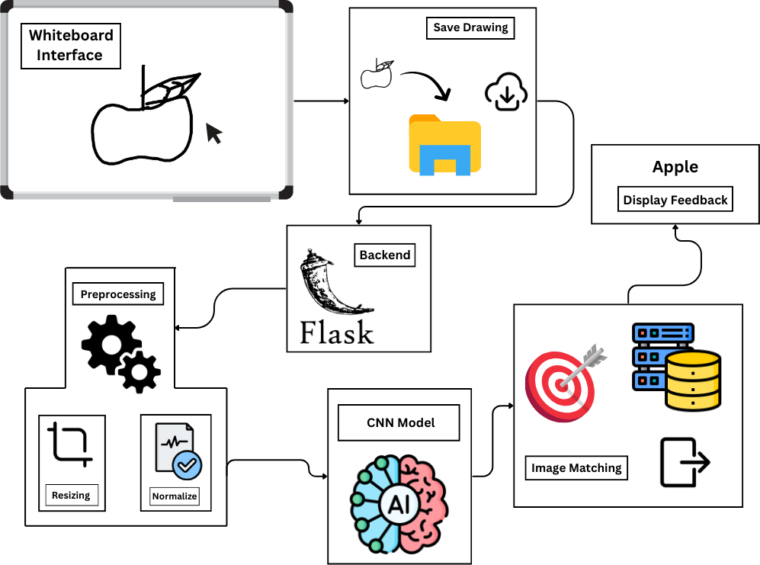
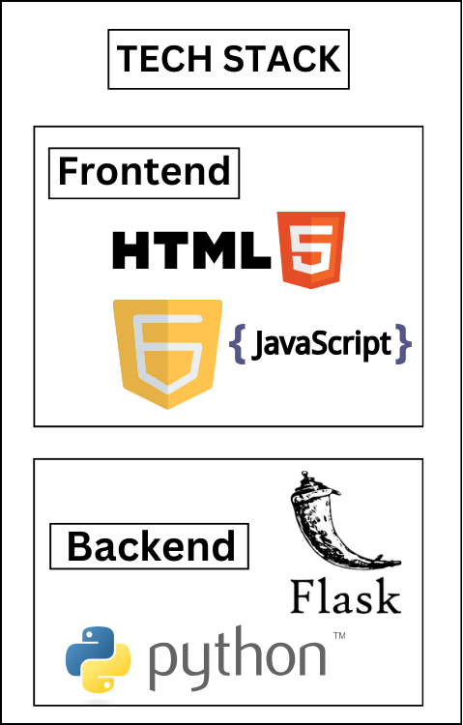
ARCHITECTURE DIAGRAM

Slide 4
LIST OF MODULES
Drawing Interface: Lets users draw on a whiteboard using a mouse or touchscreen.
Image Processing: Saves and preprocesses drawings (resizing and normalizing) for recognition.
Object Recognition: Uses the CNN model to classify and identify sketches.
Image Matching: Matches recognized objects with a predefined dataset for relevant results.
Feedback Display: Provides users with immediate visual feedback on the recognized objects.

Slide 5
RESULT AND CONCLUSION
Fast Recognition:
Real-time object recognition with high accuracy using the Convolutional neural network model.
User-Friendly Interface:
Easy-to-use whiteboard for drawing and immediate feedback on results.
Effective Matching:
Recognized objects are matched with the dataset, providing relevant visual feedback.

Slide 6
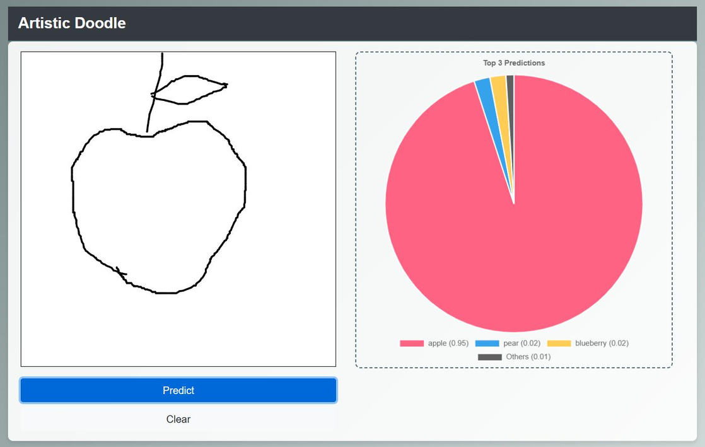
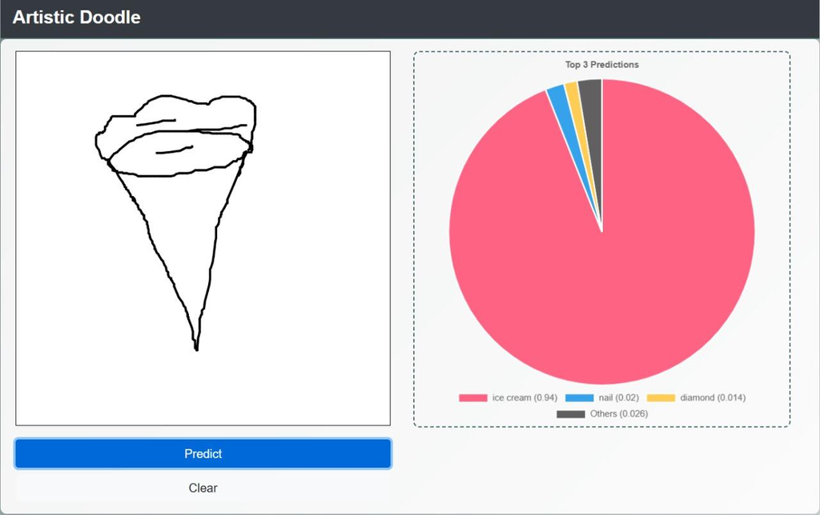
OUTPUT AND SCREENSHOTS

Slide 7
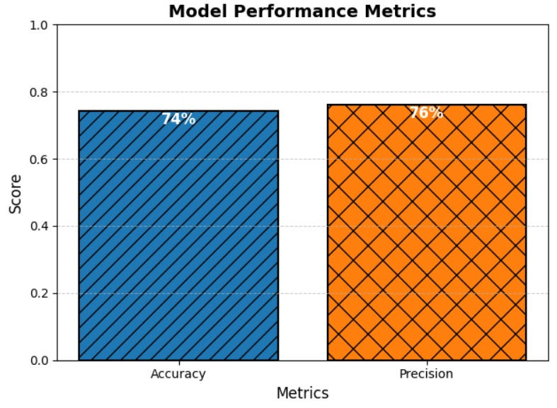
PERFORMANCE EVALUATION METRICES
Accuracy : The model correctly identifies 74% of all sketches.
Precision : 76% of the identified sketches are correctly recognized, minimizing false positives.

Slide 8
CONCLUSION
The Sketch Sense Detection project successfully uses a CNN model for fast, real-time sketch recognition.
The system provides an interactive and user-friendly whiteboard interface, enhancing user engagement.
High accuracy and effective object recognition make the model reliable for real-world applications.
Future improvements could involve expanding the dataset and refining the model for even better performance.

Slide 9
THANK YOU

